Slide 1
Social Security and Railroad Retirement Equivalent
Pub 4012 – Tab D
Pub 4491 – Lesson 15
Notes:
Social Security is frequently seen in Tax-Aide prepared returns
All counselors should have a thorough working knowledge of this material
Lump-Sum benefits are not often seen – it is at the end of this lesson as a Comprehensive topic

Slide 2
Intake and Interview
All Social Security income in scope
Refer lump-sum payment for prior year to experienced Counselor
Prior year returns are required to complete lump-sum payment
Notes:
Ask for Social Security statement SSA-1099 and/or Railroad Retirement RRB-1099 if line 13 is checked either Yes or Unsure.
If any lump-sum payments, does taxpayer have returns for those years?

Slide 3
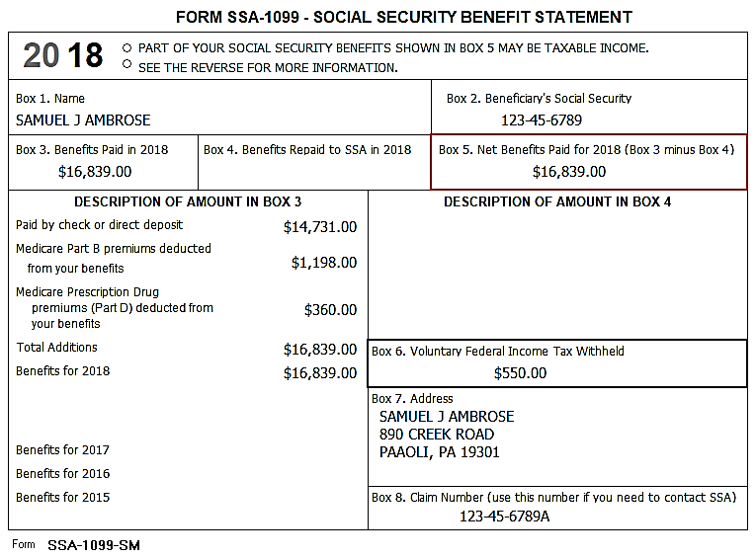
Form SSA-1099
Notes:
Make sure to use Form SSA-1099 and not the estimate for the next year. Sometimes taxpayers mistakenly bring in that form.
TaxSlayer takes Medicare premiums (combine and enter total on Social Security screen) to Schedule A medical expenses. See slide 5 if taxpayer is self-employed and qualifies for self-employed health insurance deduction.

Slide 4
Social Security Income in TaxSlayer
Pub 4012 Tab D
Enter data for both Taxpayer and Spouse
Enter any federal withholding

Slide 5
Social Security Income in TaxSlayer
Pub 4012 Tab D
Before entering Medicare insurance cost
Taxpayer with Schedule C business income enter Medicare costs as self-employed health care expense
if taxpayer qualifies*
Taxpayers with no Schedule C enter Medicare costs on Social Security screen
Carried automatically to Schedule A
* See Adjustments to Income training slides for self-employed health care deduction requirements
Notes:
Don’t double count the Medicare costs. If qualified, the Line 29 deduction will provide the better deduction for taxpayer and do not enter on the Social Security Income Screen so TaxSlayer does not post to Schedule A.
From Pub 4491: Self-employed taxpayers who reported a net profit on Schedule C or Schedule C-EZ for the year may be able to deduct the cost of their health insurance paid as a deduction to their adjusted gross income. The insurance plan must be established under the trade or business and the deduction cannot be more than the earned income from that trade or business.
Medicare premiums voluntarily paid to obtain insurance in the taxpayer’s name that is similar to qualifying private health insurance can be used to figure the deduction. Self-employed taxpayers cannot deduct payments for medical insurance for any month in which they were eligible to participate in a health plan subsidized by their employer, a spouse’s employer, or an employer of the taxpayer’s dependent or child under age 27 at the end of the tax year. Taxpayers cannot deduct payments for a qualified long-term care insurance contract for any month in which they were eligible to participate in an employer-subsidized long-term care insurance plan.

Slide 6
Railroad Retirement Benefits
Railroad Retirement Tier 1
Blue form
RRB-1099
Same Rules as Social Security
Enter data on Social Security line SSA-1099 input screen
Green form is RR Tier 2 – see Retirement Income lesson

Slide 7
Missing SSA-1099
Absent SSA-1099 subject to Local Coordinator approval
Use statement of benefits to be paid SSA-4926 for 2018
Use 2017 amount and adjust for cost of living
Adjustment for 2018 is 2.0%
(compute as 2017 amount x 1.02%)
Taxpayers with existing Social Security accounts
https://secure.ssa.gov to access information
Notes:
Account at secure.ssa.gov is taxpayer responsibility. Requires taxpayer email address. Not a task for counselors.

Slide 8
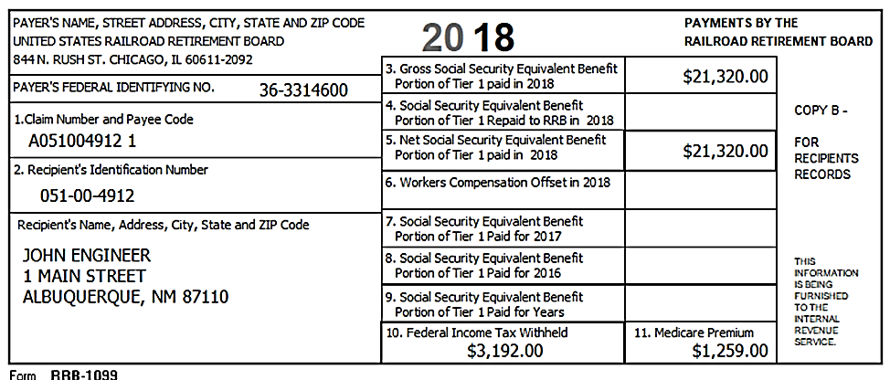
Railroad Retirement Benefits
Confirm it’s SS equivalent and not RR retirement
Notes:
Click 1 – Box 5 Net Social Security Equivalent Benefit to be entered on SSA-1099 input screen.
Click 2 – Box 11 – Medicare Premium total.
Click 3 – Box 10 – Federal Income Tax Withheld.

Slide 9
Foreign Old Age Payments
NTTC Modified Pub 4012 Tab D
Treated as U.S. Social Security (Pub 915)
Canada Pension Plan
Quebec Pension Plan
Old Age Security from Canada
Germany social security
Taxpayer must provide US dollar amounts
Other countries and pensions other than above – out of scope

Slide 10
Quality Review
Check accuracy of input
Particularly Federal income tax withheld
Medicare – on right form (Schedule C or Schedule A)
Determine if lump-sum worksheets needed if benefits shown for multiple years
Notes:
Lump-sum worksheet comprehensive lesson next section

Slide 11
Lump-sum Social Security
Comprehensive

Slide 12
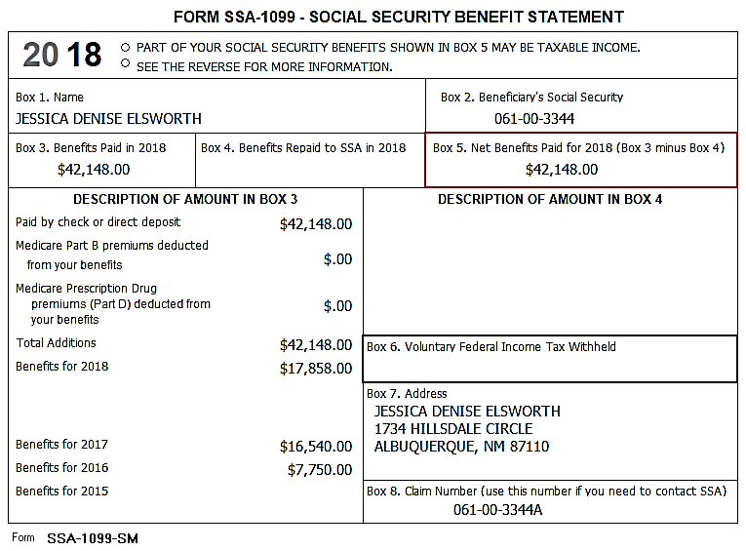
SSA -1099 Lump Sum Distribution
Benefits paid may include lump-sum payments for prior years
Prior year amounts shown in description block Form SSA-1099
Notes:
If attorney fees are included in the Description of Amount in Box 3 section, those attorney fees are no longer deductible on Schedule A however, check for possible state deduction still in place.

Slide 13
Lump-Sum Social Security
Do not amend prior year returns for lump-sum Social Security payments
Taxing full Social Security amount in 2018 may not change tax if none is taxable or no tax liability
Use lump-sum calculation if portion of Social Security income taxable and there is a tax liability
Check the Summary after entering all other tax return data
Notes:
13
Sometimes if a taxpayer files for disability, it takes a long time to work through the approval process. This can result in social security allocated to several years. An example is shown on the next chart.
For multiple year social security it may be possible that there isn’t any tax impact if all of the social security is entered as lump-sum for the current year. If there is an impact it may be better to use lump sum worksheets for each year; however, the AGI, taxable social security, total social security and tax exempt interest are needed for each year. If lump sum is used, taxpayer must have tax returns available for those years.

Slide 14
Start With SSA-1099 Input Screen
Enter entire amount on current year input screen
Begin Worksheet for Lump-Sum Payments
Select prior year and enter requested information
Find SSA-1099 Lump-Sum Distributions page in Pub 4012 Tab D for data entry
Notes:
Taxpayer MUST have previous year(s) return(s)

Slide 15
Lump-Sum Calculation
NTTC Modified Pub 4012 Tab D
Modified AGI for lump-sum calculation includes
Adjusted gross income
Plus tax-exempt interest
Plus certain adjustments
Adjustments
Student loan interest
Tuition and fees
Adoption benefits (Form 8839)
Qualified U.S. savings bond interest (Form 8815)
Domestic production activities (for 2005 through 2016)
Foreign earned income or housing (Form 2555 or Form 2555-EZ)
Certain income of bona fide residents of American Samoa (Form 4563) or Puerto Rico

Slide 16
Lump-Sum Calculation
Taxpayer must have copies of prior year returns
Enter Social Security income received in prior year
TaxSlayer calculates and applies lower taxable amount from Lump-Sum worksheets to current year return

Slide 17
Social Security Income
Questions?
Comments ...

